Slide 1
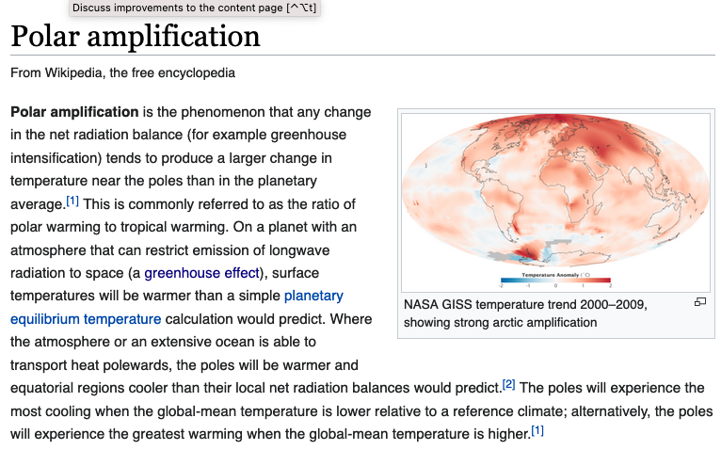
Polar amplification

Slide 2
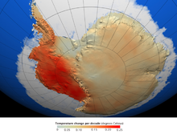
Polar amplification

Slide 3
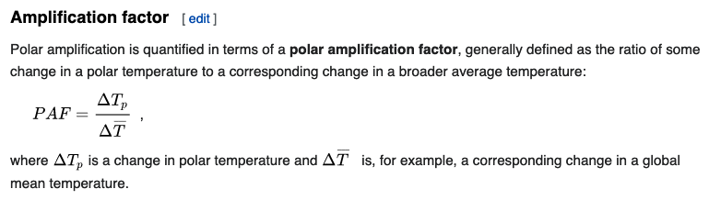
Polar amplification

Slide 4
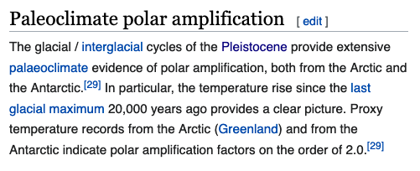
Polar amplification

Slide 5
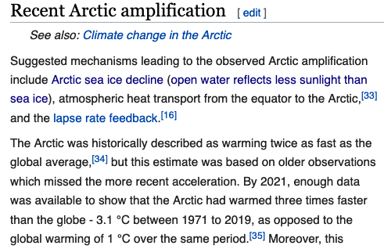
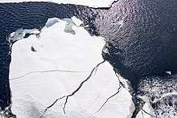
Polar amplification

Slide 6
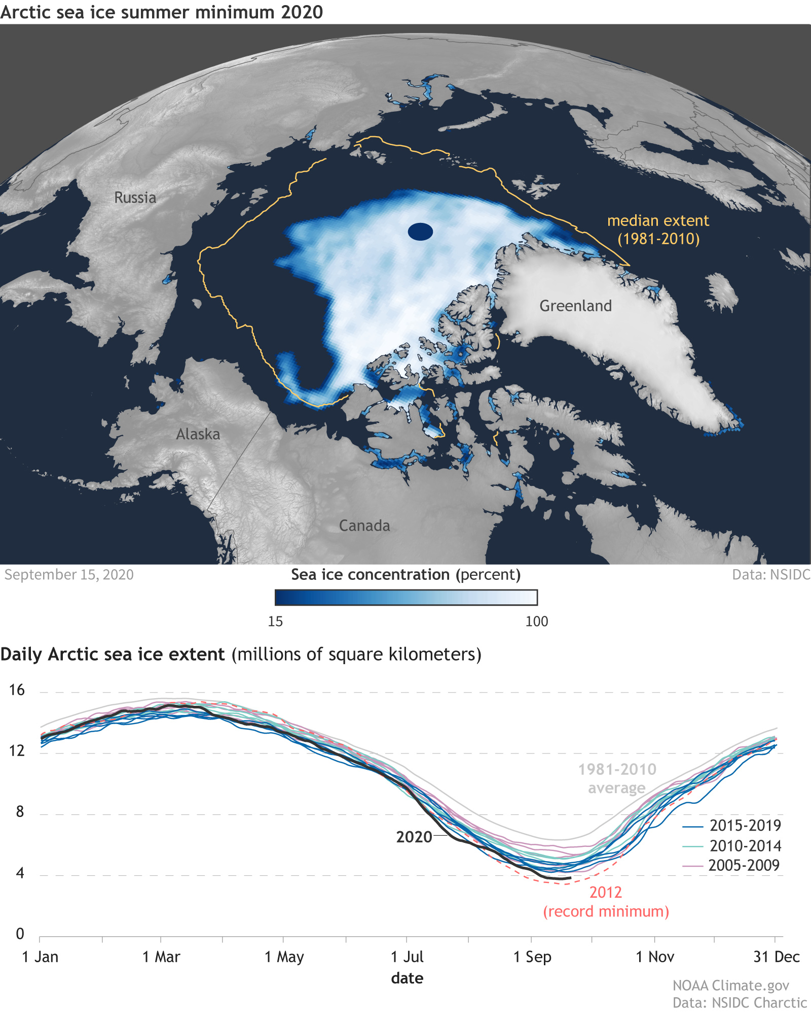
Recent trends in Arctic sea ice extent
September 15
2020
Notes:
https://e360.yale.edu/features/how-the-world-passed-a-carbon-threshold-400ppm-and-why-it-matters

Slide 7
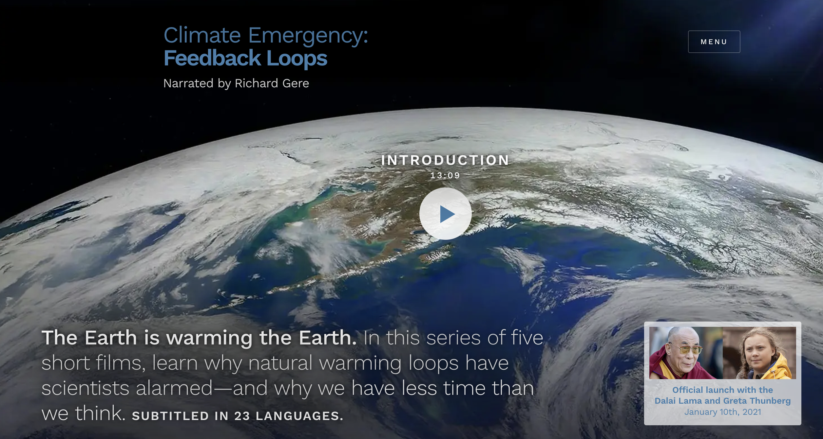
Survey of feedback loops in the climate system - Albedo
George Woodwell
Woods Hole Oceanographic Institute & WCI
(Photos depict 1970s Arctic research done by UPS’s Alan Thorndike, OSU’s Steve Neshyba, many others)
www.woodwellclimate.org/
Jennifer Francis, Rutgers, WCI
Testified to US House Committee on Science, Space, and Technology, 2019
Connections between Arctic amplification and weather patterns in mid-latitudes, predicting more persistent weather regimes, like the multi-year California droughts
Marika Holland, section head for the Paleo and Polar Climate Research at NCAR
https://feedbackloopsclimate.com/
www.woodwellclimate.org/
https://www.woodwellclimate.org/staff/jennifer-francis/
https://staff.ucar.edu/users/mholland

Slide 8
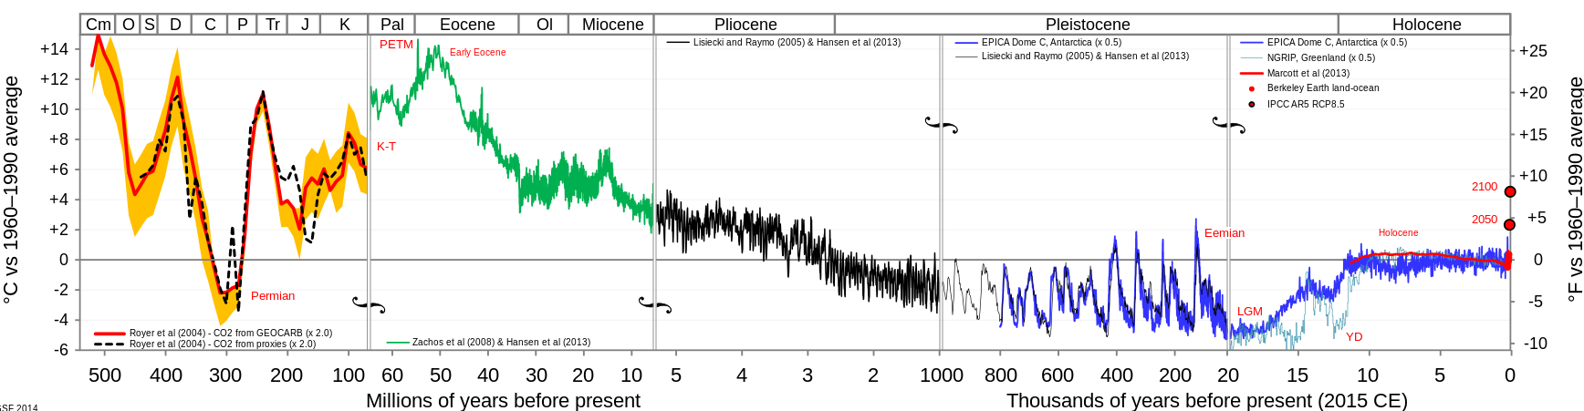
Potential sea level changes due to changes in the cryosphere
time
Greenland ice sheet forms
Hothouse Earth
Icehouse Earth
Permanent ice in East Antarctic forms
65 meter drop in sea level
+/- 110 meters during “ice ages” (but we’re already at +110 b/c we’re in an interglacial

Slide 9
Potential sea level changes due to changes in the cryosphere
time
Greenland ice sheet “melts”
Hothouse Earth
Icehouse Earth
Permanent ice in East Antarctic “melts”
65 meter rise in sea level
+/- 110 meters during “ice ages” (but we’re already at +110 b/c we’re in an interglacial

Slide 10
Glacial-interglacial cycling
“Tacoma” buried under a couple of kilometers of ice
Wild swings in temperature
Low CO₂
Lots more arable land
More stable
Higher CO₂
Less ice
Lots of ice
Interglacial conditions
10,000 years
Glacial conditions
90,000 years

Slide 11
Anthropocene: Like an extended Holocene
Anthropogenic GHG emissions have prevented our scheduled return to glacial conditions
Next alignment of Earth’s orbital wobbling that will open the door to interglacial conditions is 50,000 years from now!
“Anthropocene”
50,000 years
Glacial conditions
90,000 years

Slide 12
Unless we transition to Hothouse Earth
Hothouse Earth
Interglacial conditions
Glacial conditions
90,000 years

Slide 13
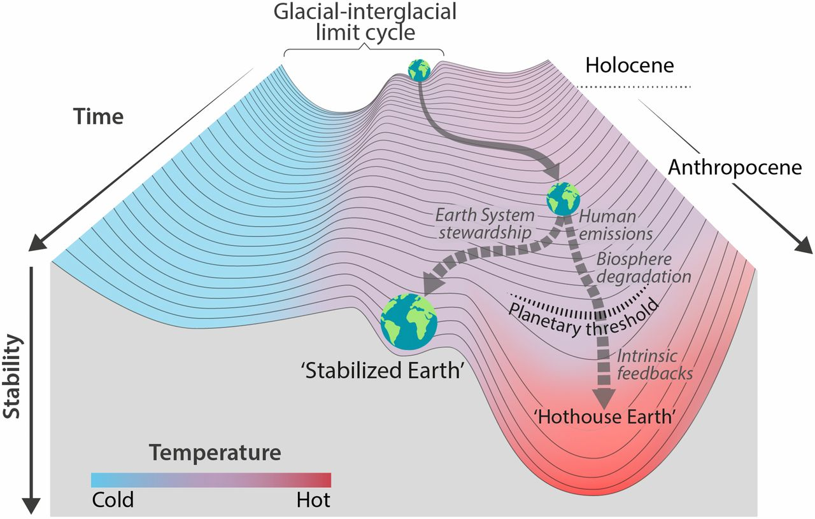
Tipping points to hothouse Earth
In 2021, we’re at +1.2 degrees relative to pre-industrial times
+1.5 degrees relative to pre-industrial times has been called “safe”
Nobody knows:
What the threshold is
How long it might take to make the transition to Hothouse Earth
*
Steffen et al, PNAS 2018: https://www.pnas.org/content/115/33/8252

Slide 14
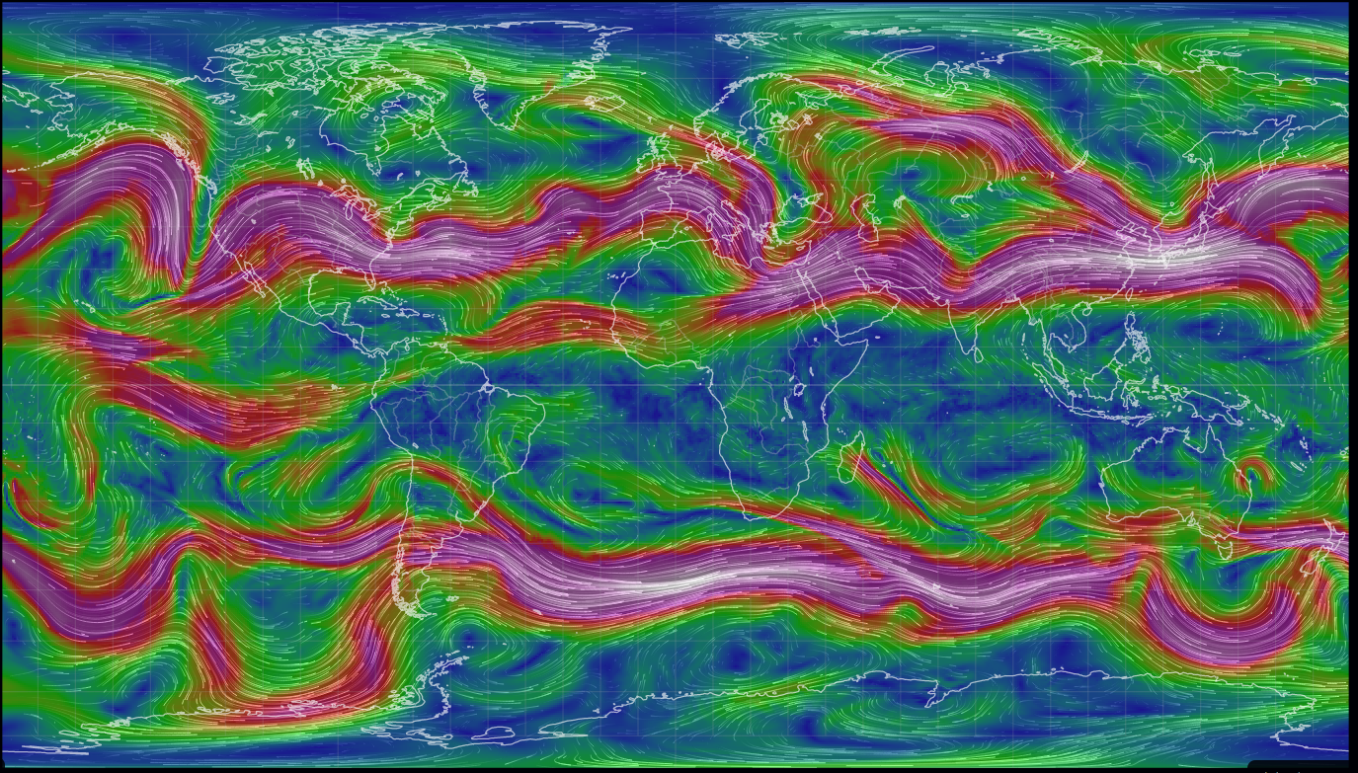
Jet stream forms a meandering boundary between cold Polar air and warmer mid-latitude air
Cold Arctic air
Warm mid-latitude air
Cold Antarctic air

Slide 15
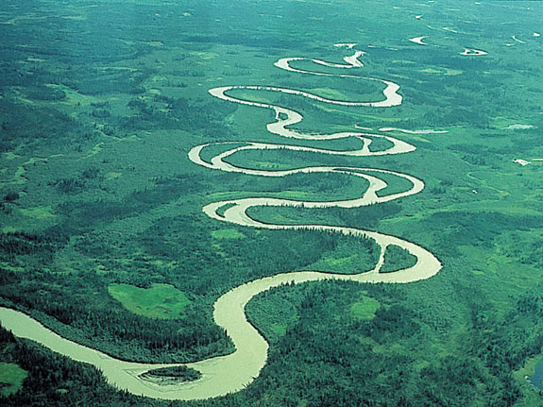
But meandering happens more when the terrain is flat

Slide 16
Warmer Arctic -> less temperature difference between Arctic and mid-latitude -> jet is wavier and slower
Cold Arctic air
Warm mid-latitude air
Cold Antarctic air

Slide 17
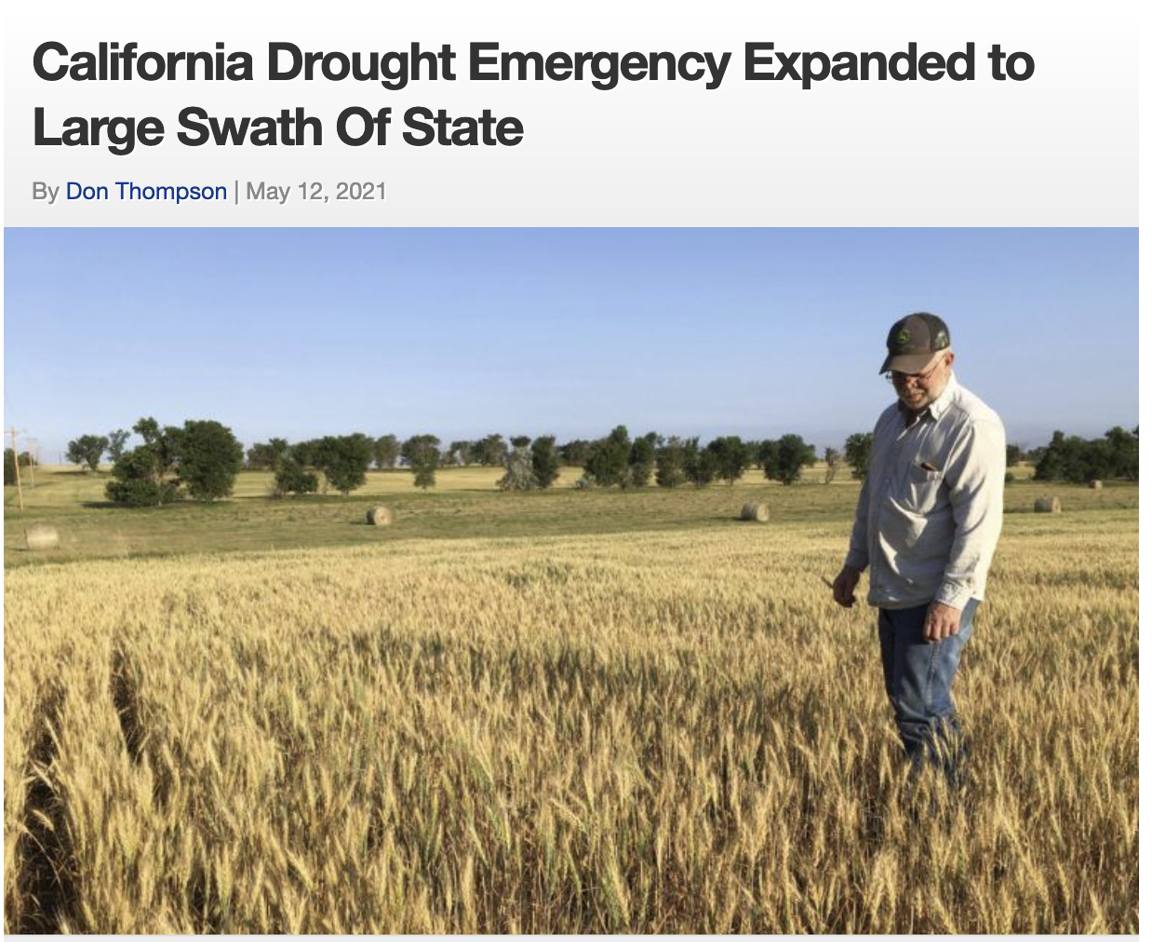
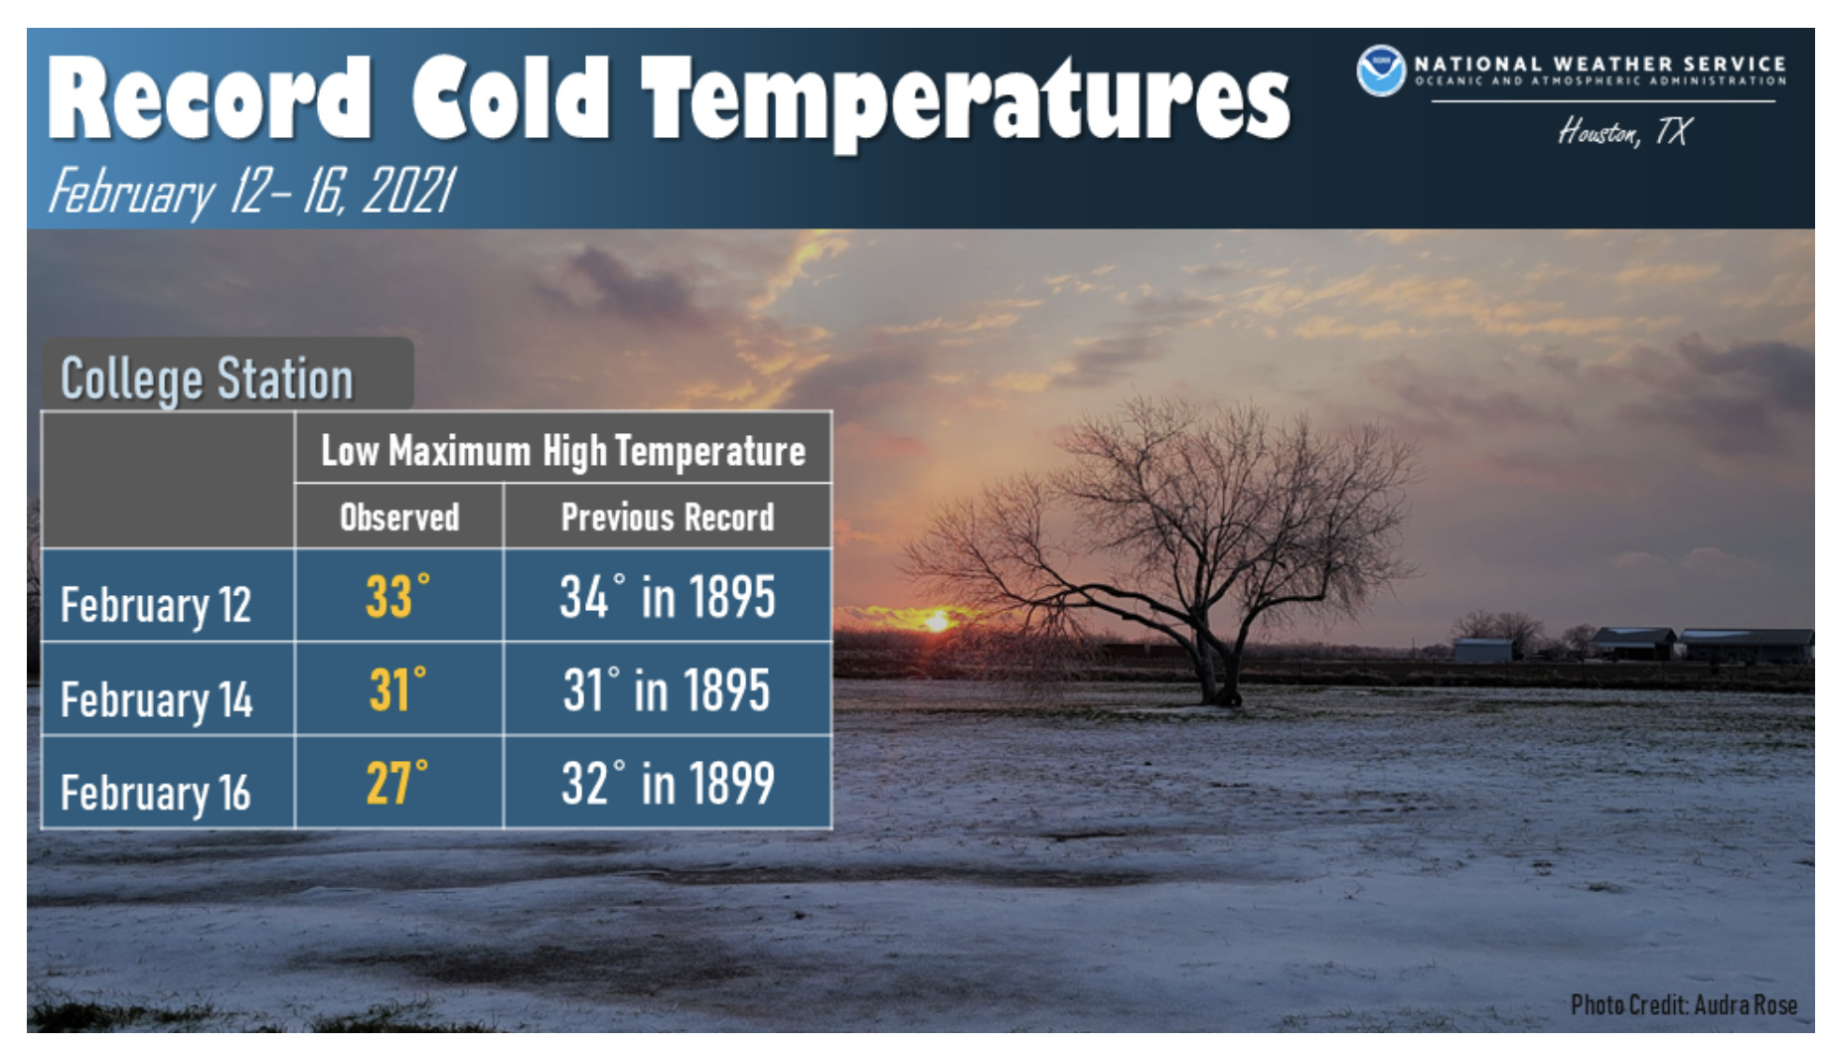

Warmer Arctic -> less temperature difference between Arctic and mid-latitude -> jet is wavier and slower -> prolonged periods of drought and cold

Slide 18
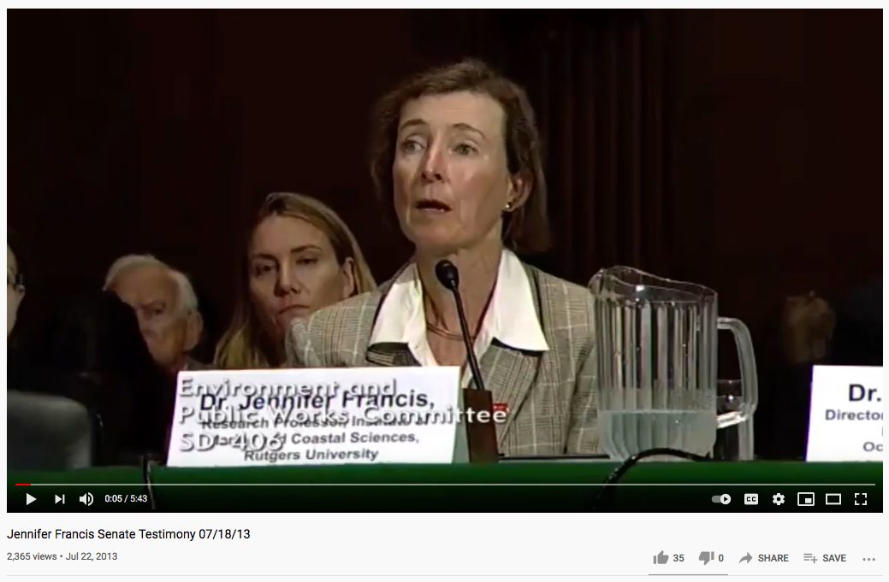
This idea was pioneered by Francis and Vavrus
https://www.youtube.com/watch?v=8eyNm2QcOw8&feature=youtu.be

Slide 19
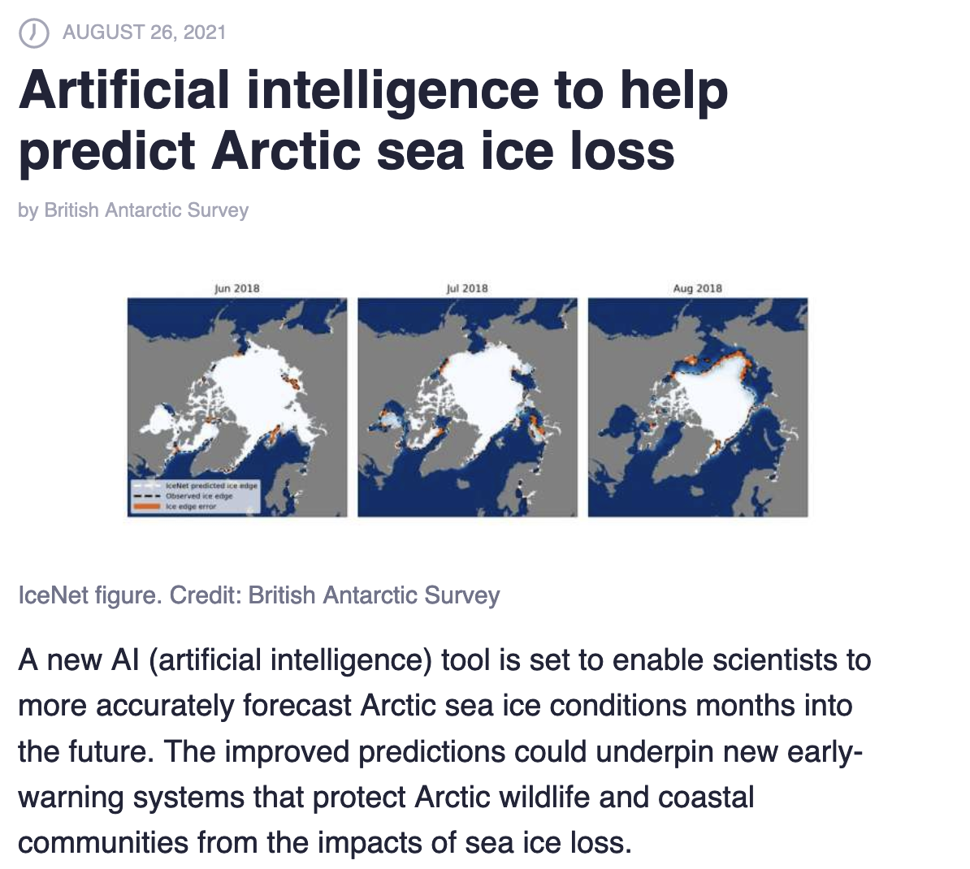
AI-based modeling of Arctic sea ice in the short term
Introduction by Tom Andersson:
https://youtu.be/lzJA7r0oNcg
Code available at:
https://github.com/tom-andersson/icenet-paper

Slide 20
Mapping out the rest of the semester
Week 11
Complete/submit all CGIs assigned so far by Friday 11 November (end of next week)
Talk about methodologies for exploring nonlinearities, feedbacks, and tipping points; discuss the other three FeedbackLoop videos; EnROADS scavenger hunt
Offline: groups of 2-3 meet with me to pitch your project idea
Weeks 12/13 (includes Monday of Thanksgiving week)
Next week’s CGI will be due Monday 14 November (EnROADS/Cambio3.0)
Group work on your projects
Weeks 14 & 15
Your presentations (~15 minutes each)
All remaining CGI submissions/resubmissions must be uploaded by the last day of classes
Week 16 (Finals week)
1-on-1 interviews

